Slide 2
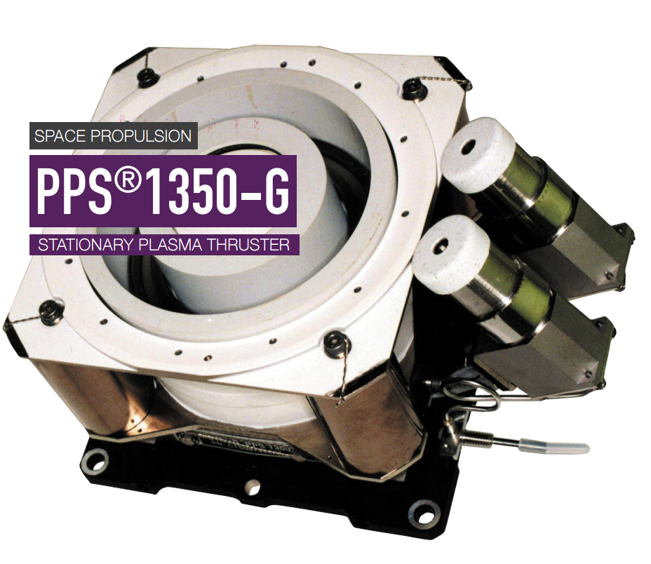
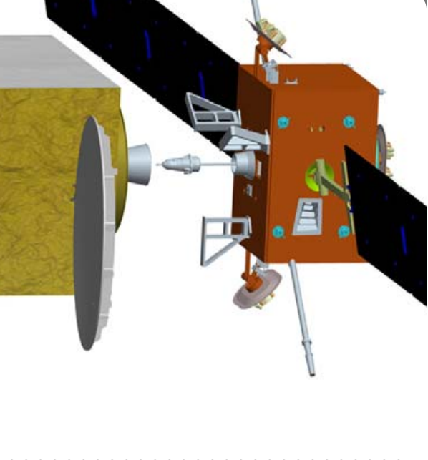
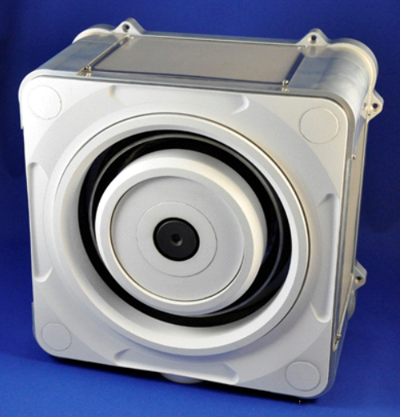
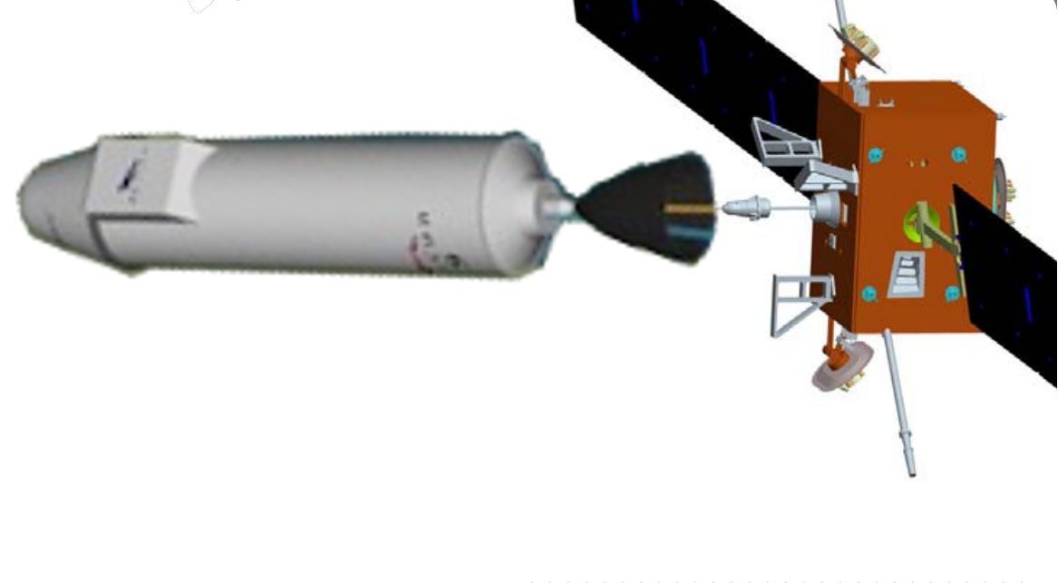
Satellite mass and dimension establishment
Baseline: SMART-OLEV
Similar mission, similar design
Detailed comparison
Ref: Safran Aircraft Engines
 | SMART-OLEV | Ours
General | Similar design
Thrusters | 6 x PPS-1350-G | BHT-8000
Thrusters’ mass | 6 x 5.30kg = 32kg | 25 kg
Thrusters’ power | 6 x 1.5kW = 9kW | 8 kW
Battery’s mass |  | 20 kg
Propellant’s mass | 350 kg | 300 kg
Totally | 1 ton | 1 ton – 37kg ≈ 1 ton
Ref: Smart-OLEV project
Ref: Busek Co.
Ref: Spaceflight Now Inc., Photoshoped.

